Slide 1


HOW TO MAKE A “PERFECT” GIT COMMIT
Kawtar CHOUBARI (@choubari_)
Slides template provided by slidesgo.com

Slide 2
ABOUT THE PILOT
Software Engineer (Front & Mobile)
Content Creator (Part-Time)
Github: @choubari
Twitter / Instagram: @choubari_
LinkedIn / YouTube: Kawtar CHOUBARI
@choubari_

Slide 3
AGENDA
01
02
Perfection doesn’t exist…
Are you sure?
03
04
Show me how!
What’s next!?
@choubari_

Slide 4
Perfection doesn’t exist but…
You can set up guidelines to create better commits
@choubari_

Slide 5
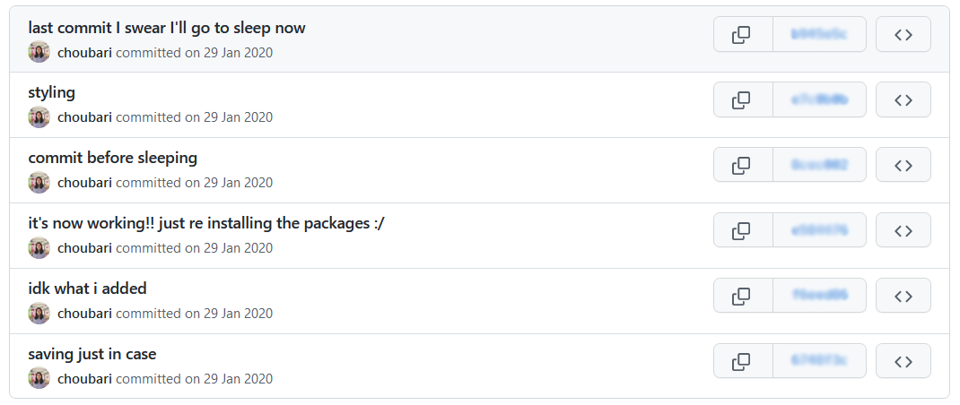
@choubari_

Slide 6
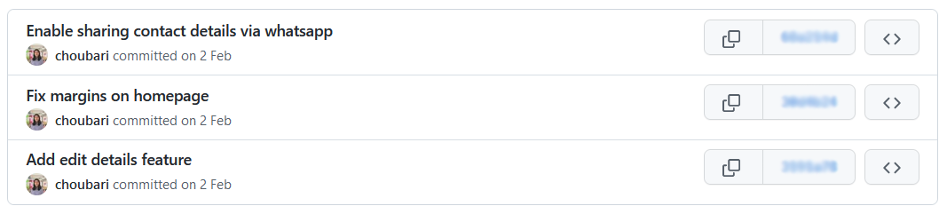
Name a better commit message
Limit the subject line to 50 characters
Use imperative mood
Remove unnecessary punctuation marks
Use the body to explain what and why the change was made
Make the commit message semantic and machine-readable for task automation
@choubari_

Slide 7
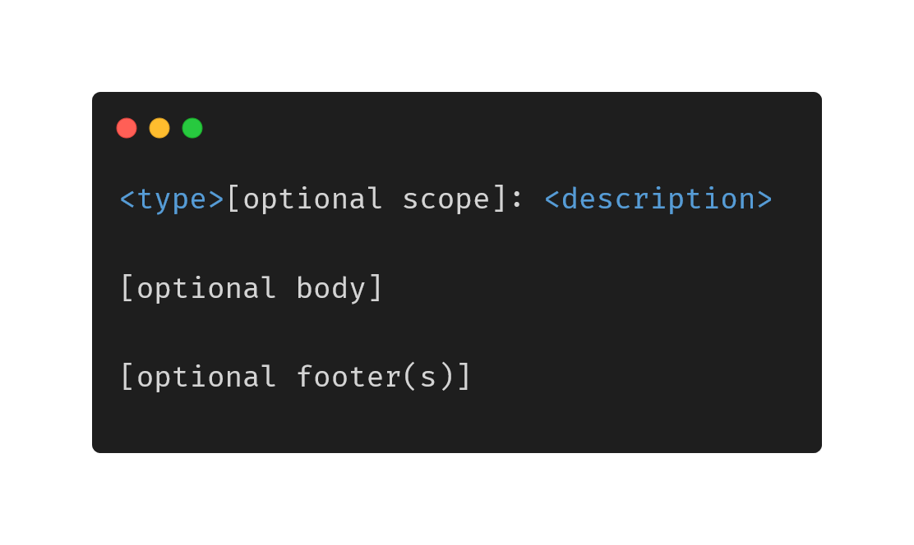
Conventional Commits
feat: A new feature
fix: A bug fix
refactor: Code refactoring
test: Additions or modifications to test cases
docs: README, or anything related to documentation
chore: Regular code maintenance
https://www.conventionalcommits.org/
@choubari_
Notes:
Conventional commits
Example:
fix: fix foo to enable bar
This fixes the broken behavior of the component by doing xyz.
BREAKING CHANGE
Before this fix foo wasn't enabled at all, behavior changes from <old> to <new>
Closes D2IQ-12345

Slide 8

Save time for the next commits
@choubari_

Slide 9

Git Hooks
LOCAL - Client Side
REMOTE - Server Side
Changes to commit
p
Repo Update
Commit
Push
pre-commit
commit-msg
pre-receive
prepare-commit-msg
post-commit
update
post-receive
https://githooks.com/
@choubari_
Notes:
https://www.atlassian.com/git/tutorials/git-hooks

Slide 10
Show me how!
Let’s do a quick demo
@choubari_
Notes:
Demo: Ensure we are adding a reference to our Jira ticket in the commit message
https://gist.github.com/choubari/c89b685c334939d581489c537b5bda2f

Slide 11
What’s Next!?
You can easily set guidelines and automate recurring tasks
@choubari_

Slide 12
Automate tasks & code review
Format the code before a commit
Run unit tests before a commit or a push
Check if the file names and functions names are in Camel Case
Prevent pushing deprecated code
Ensure you are not committing any private keys
@choubari_
Notes:
git config --local core.hooksPath .githooks/
push git hooks to remote on .githooks folder:
https://stackoverflow.com/a/64083738/12802591

Slide 13
Thanks!
We landed safely, see you soon!
Twitter: @choubari_
Slides template provided by slidesgo.com
@choubari_

